Slide 1




Introducing Angiogenesis in Predictive
Models of Cancer Development
Student: Hossam El-Basiouny
Supervised by Matilde Palmeira, Rui Travasso

Slide 2
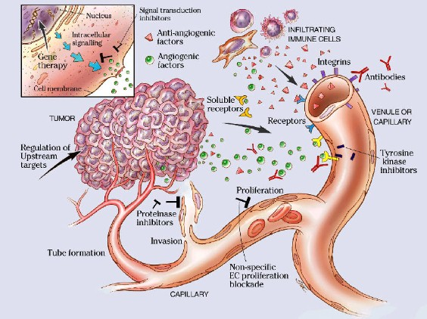
Tumors & Angiogenesis
Angiogenesis is the process by which new blood vessels from existing ones
Angiogenesis is strongly correlated with solid tumor malignity and is driven by tumor hypoxia
Relevant in varied situations in health and disease
Morphogenesis
Inflammation
Wound healing
Diabetic Retinopathy
Over 50 other pathologies
M. D. Anderson Cancer Center, Univ. of Texas

Slide 3
The goal is to explore simple predictive models of tumor growth in 2D and that includes how irrigation affects its development
The model results show how the cells move, how they grow and can be fit from longitudinal medical imaging

Slide 4
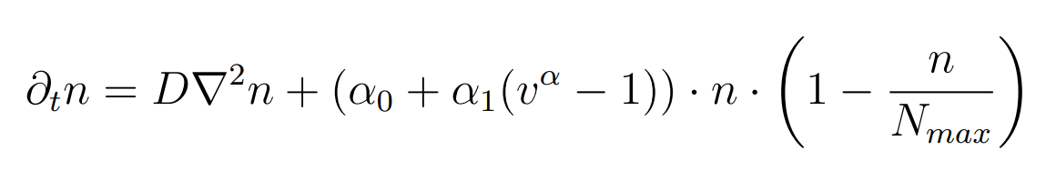
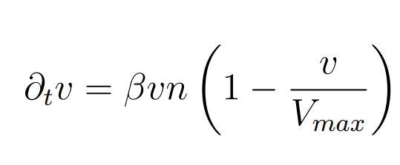


Tumor Cell Density
Irrigation
Diffusion
Proliferation
Vessel Density

Slide 5
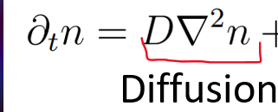
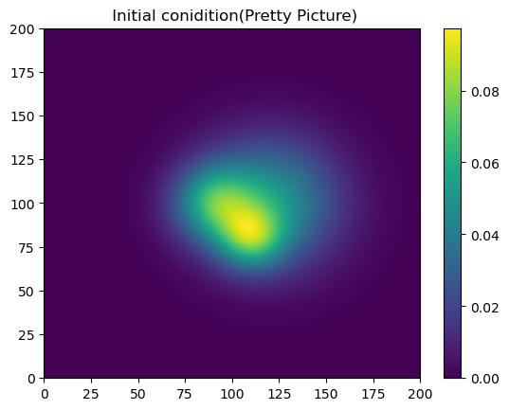
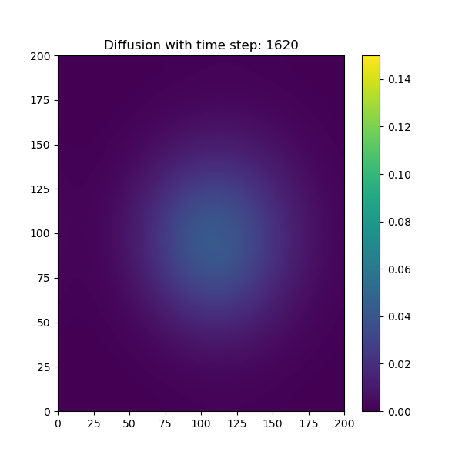
Only diffusion
D constant = 2

Slide 6
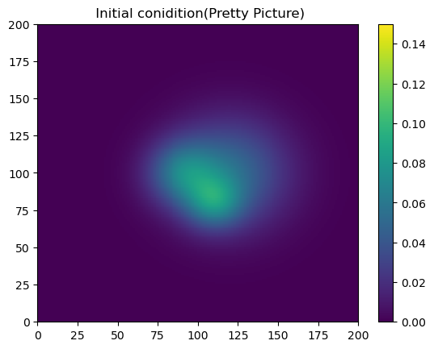
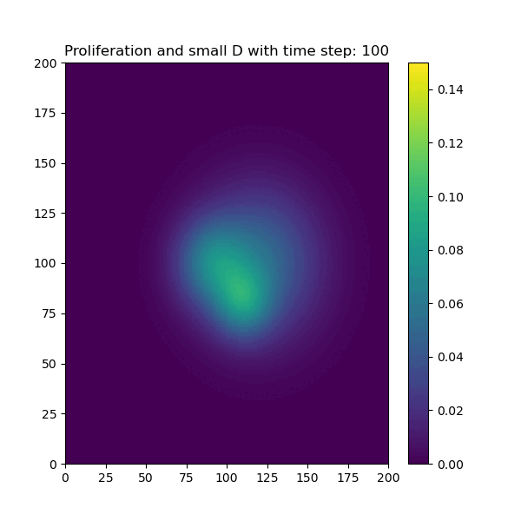
Proliferation and small diffusion
D constant = 0.001

Slide 7
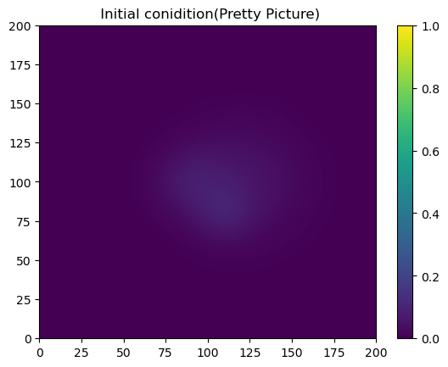
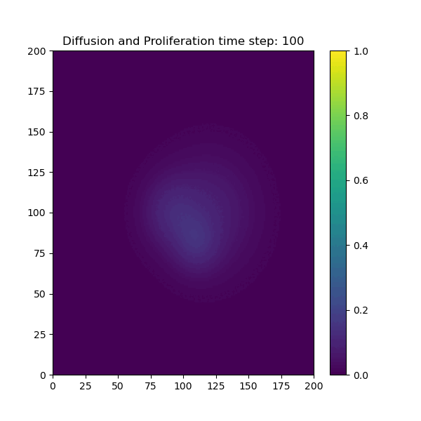
Proliferation and diffusion
D constant = 0.05

Slide 8
How does the vessel density affect the tumor growth?
Now Adding Vessels and evaluating how the tumor grows with small β (0.001) and larger β (0.1)
β = Vessel Growth
υ = Vessel density

Slide 9
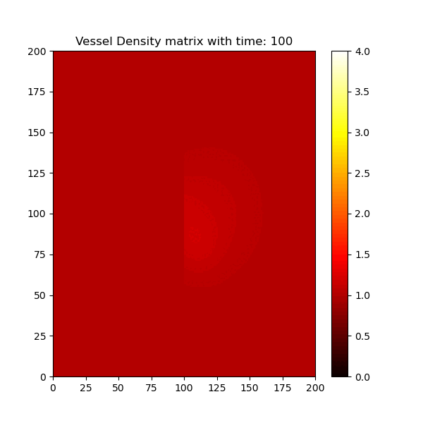
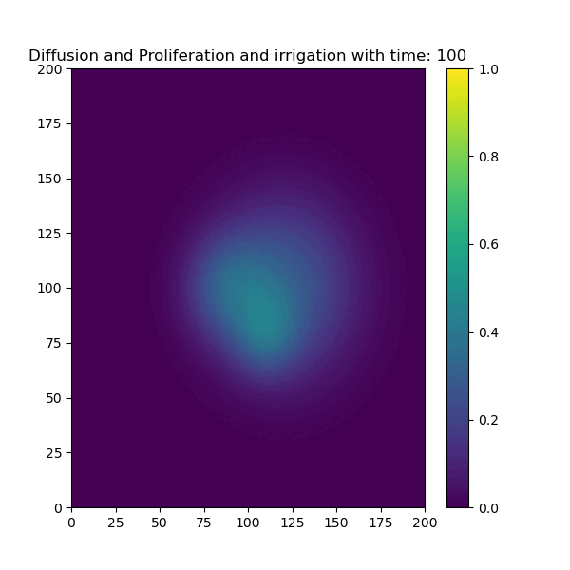
it turns out more vessel density
More Tumor Growth
Diffusion constant = 0.2
β= 0.001
β=0.1

Slide 10

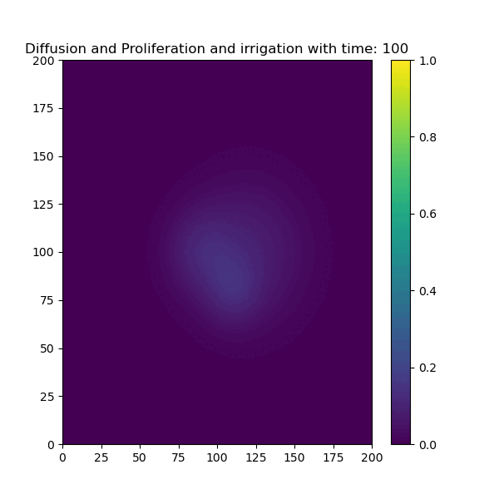
This time with smaller diffusion constant which shows
Diffusion constant = 0.05
β= 0.001
β=0.1

Slide 11
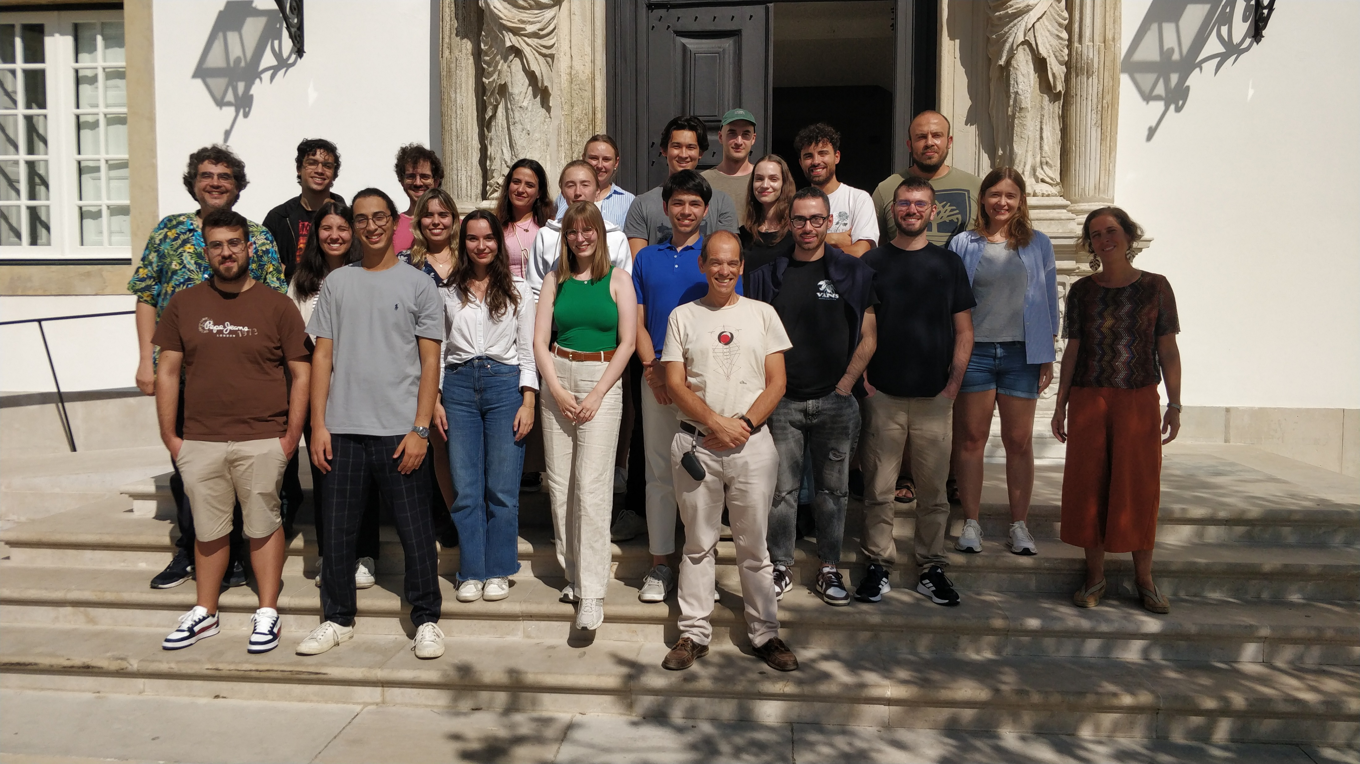
Thank you <3

